Slide 1

AirLytics: Smart Air Quality Prediction System
Transforming environmental monitoring through machine learning and real-time analytics for healthier communities

Slide 2

The Critical Importance of Air Quality Monitoring
Air pollution ranks among the world's most severe environmental health risks, contributing to millions of premature deaths annually. Effective air quality prediction systems empower communities, healthcare providers, and policymakers to take proactive measures against pollution exposure.
Public Health Impact: Accurate forecasts enable vulnerable populations to modify outdoor activities during poor air quality days, reducing respiratory and cardiovascular health risks.
Environmental Management: Continuous monitoring helps identify pollution sources, track regulatory compliance, and measure intervention effectiveness over time.

Slide 3




Project Overview: Machine Learning at the Core
Random Forest Regression
Comprehensive Data Sources
Ensemble learning approach combining multiple decision trees for robust predictions with built-in feature importance analysis
Historical pollutant concentrations (PM2.5, PM10, NO₂, SO₂, CO, O₃) combined with meteorological parameters
Prediction Targets
Hourly and daily Air Quality Index (AQI) forecasts with confidence intervals for uncertainty quantification
Our methodology leverages ensemble methods that excel at handling non-linear relationships between weather conditions and pollutant behavior, while providing interpretable feature importance rankings.

Slide 4



Three-Tier System Architecture
Machine Learning Engine
Backend API Layer
Frontend Interface
Trained Random Forest models deployed for real-time prediction generation with automated retraining pipelines
Flask-based RESTful interface handling data ingestion, model inference, and result formatting with database persistence
React-powered responsive dashboard delivering interactive visualizations and accessibility across devices
Data Pipeline Components
Processing Techniques
Automated data collection from environmental sensors
Quality control and outlier detection routines
Feature engineering for temporal patterns
Missing data imputation using temporal correlations
Normalization and scaling for model consistency
Batch prediction generation for forecasting horizon

Slide 5
Model Development and Training Process
Training Methodology
Evaluation Framework
Our Random Forest models were trained on multi-year historical datasets spanning diverse meteorological conditions. The training process employed time-series cross-validation to ensure temporal independence while preventing data leakage.
Comprehensive metrics assessed both accuracy and reliability of predictions:
RMSE (Root Mean Square Error): 12.8 units, indicating average deviation magnitude
MAE (Mean Absolute Error): 8.4 units, representing typical prediction error
R² Coefficient: 0.87, showing strong explanatory power
Key steps included:
Hyperparameter tuning using grid search with k-fold validation
Feature selection based on correlation analysis and domain knowledge
Model validation on holdout test periods
These results demonstrate the model's ability to capture 87% of AQI variability while maintaining consistent error margins.

Slide 6




Backend and Frontend Implementation
Flask REST API
React Dashboard
Visualization Tools
Lightweight, scalable backend framework providing endpoints for data queries, model predictions, and system status monitoring with JSON-based data exchange
Component-based frontend architecture delivering real-time visualizations, historical comparisons, and downloadable reports with intuitive user experience
Interactive charts using D3.js and Chart.js libraries enable users to explore trends, compare predictions with actual measurements, and identify pollution patterns
Technical Highlights: The system employs asynchronous processing for long-running predictions, implements rate limiting for API stability, and uses WebSocket connections for real-time alert notifications when AQI exceeds threshold levels.

Slide 7
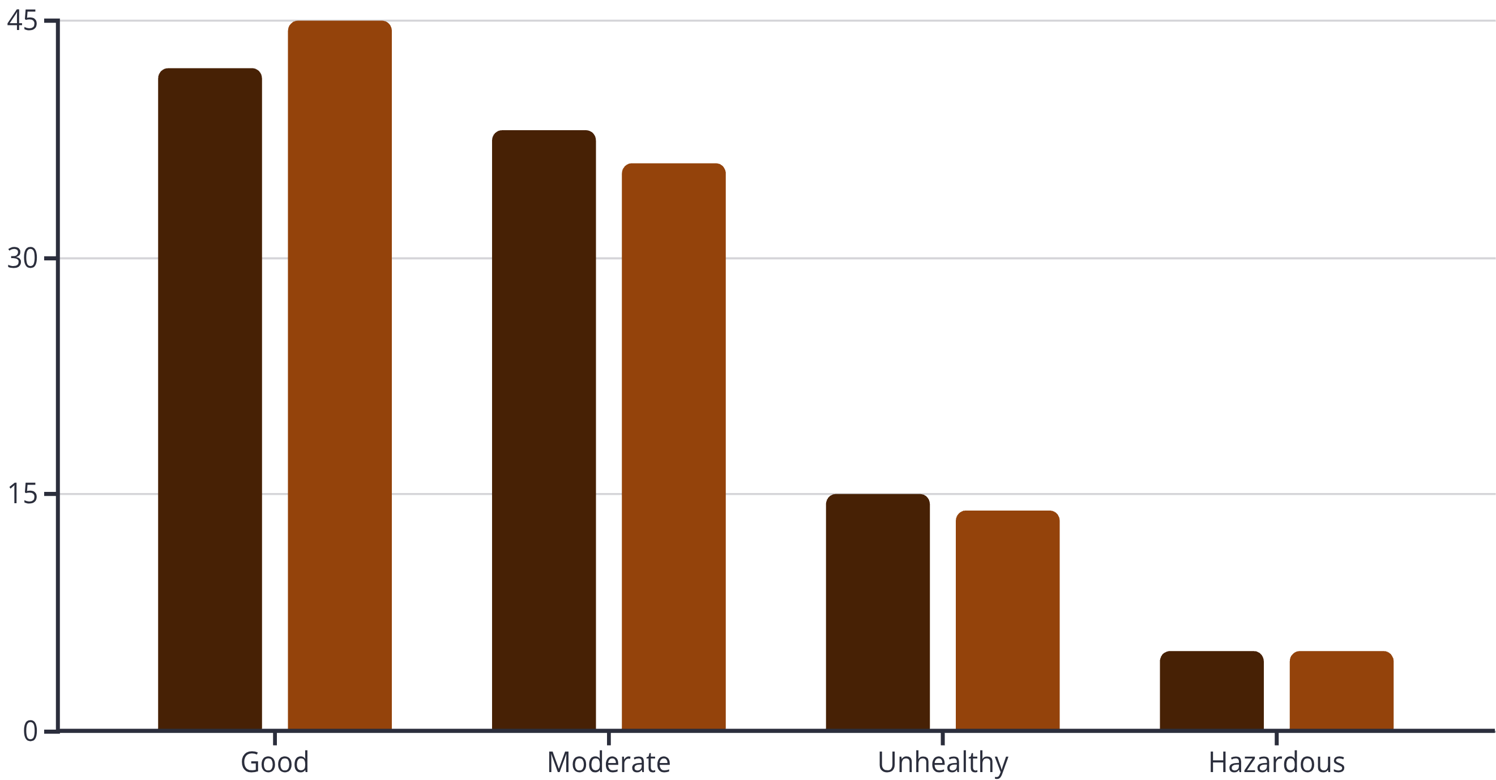
Results and Performance Insights
Our evaluation compared predicted AQI values against actual measurements across different pollution categories and seasonal periods.
Predicted
Actual
Key Findings
Limitations Identified
The model demonstrates strong performance across all AQI categories, with particular accuracy in identifying extreme pollution events. Predictions show consistent patterns with actual measurements.
Performance slightly degrades during rapid weather transitions and under unusual atmospheric conditions not well-represented in training data. Future improvements should address these edge cases.

Slide 8

Applications and Real-World Impact
1
Public Health Organizations
Early warning systems enable health departments to issue advisories, allocate medical resources, and protect vulnerable populations during pollution events
2
Policy Development
Long-term trend analysis supports evidence-based environmental regulations, emission control strategies, and urban planning decisions
3
Smart City Infrastructure
Integration with IoT sensors and traffic management systems optimizes pollution mitigation through dynamic routing and infrastructure adjustments
4
Environmental Monitoring
Continuous assessment of air quality patterns identifies emerging pollution sources and evaluates effectiveness of environmental interventions
Deployed in metropolitan areas, similar systems have demonstrated measurable reductions in emergency room visits through proactive alert systems and enabled cities to implement targeted traffic restrictions during predicted high-pollution periods.

Slide 9

Conclusion and Future Enhancements
Project Achievements
AirLytics successfully demonstrates the feasibility of machine learning approaches for practical air quality prediction, achieving strong correlation with actual measurements while providing interpretable feature importance insights.
The three-tier architecture balances performance with maintainability, and the open API design facilitates integration with existing environmental monitoring infrastructure.
Future Research Directions
Ensemble Methods: Incorporating gradient boosting and neural network architectures
Spatial Analysis: Adding geographic information system (GIS) integration for pollution source mapping
Real-time Adaptation: Online learning techniques for continuous model improvement
Causal Inference: Attribution of pollution changes to specific interventions

Slide 10

Building Healthier Communities Through Data-Driven Environmental Intelligence
Immediate Actions
Research Collaboration
Partner with municipal environmental agencies for pilot deployment and validation studies
Engage public health researchers to quantify health outcome improvements from prediction-based interventions
Technology Scaling
Expand system to additional metropolitan areas with diverse climatic and pollution profiles
Contact Information: For collaboration opportunities, technical inquiries, or deployment partnerships, please reach out to our team to explore how AirLytics can support your environmental management objectives.

Slide 11
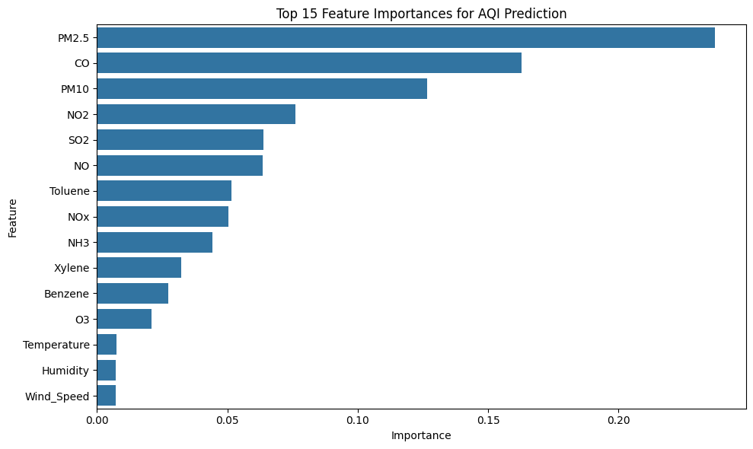

Slide 12
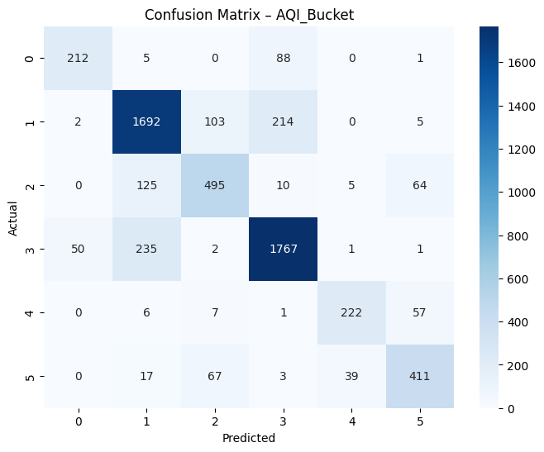

Slide 13
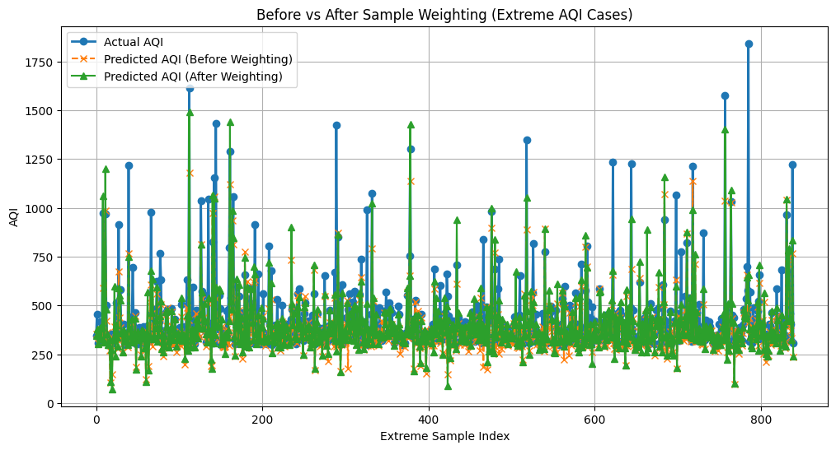

Slide 14
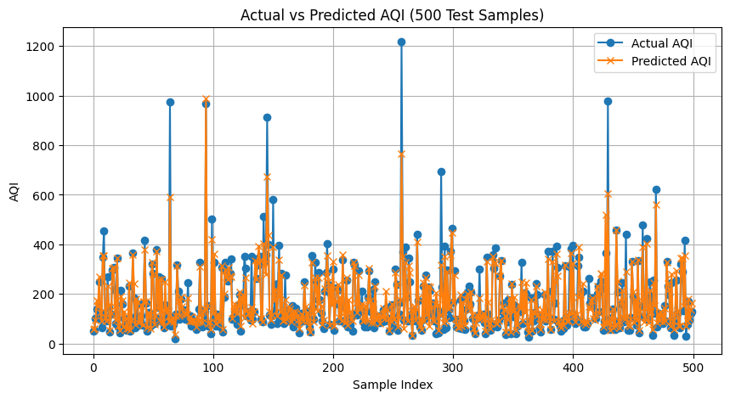

Slide 15
